Slide 1

SARS-Cov-2 Wild Type vs Representative Omicron Variant
TERM PROJECT
Team Members:
Mahima Devi Allam (Z1924638)
Dinesh Kolla (Z1935563)
Ganesh Kanadam (Z1939317)
Bioinformatics

Slide 2
Introduction
Sars-Cov2 is one of the viruses that causes the Covid19 pandemic. It belongs to the coronavirus family, and it also contains other genomes like Omicron variant which is more contagious than prior variants, it leads to large cause in community cases.
In this project, we will use pairwise alignment for Omicron like genomes, we are calculating the substitution rate and the gap rates for the genome, we also plotted some graphs in order to study the relation between Sars-Cov2 and Omicron Variant.
Bioinformatics

Slide 3
SARS Cov-2 vs Omicron
SARS-CoV-2
The virus that causes a respiratory disease called coronavirus disease 19 (COVID-19). SARS-CoV-2 is a member of a large family of viruses called coronaviruses. The incubation period of SARS CoV-2 wild-type is 5 days. December 15, 2020, to February 28, 2021. Basically, wild type gene is found in its natural, non-mutated which is the unchanged virus form.
These viruses can infect people and some animals. SARS-CoV-2 was first known to infect people in 2019. The virus is thought to spread from person to person through droplets released when an infected person coughs, sneezes, or talks. It may also be spread by touching a surface with the virus on it and then touching one’s mouth, nose, or eyes, but this is less common. Research is being done to treat COVID-19 and to prevent infection with SARS-CoV-2. Also called severe acute respiratory syndrome coronavirus 2.
Bioinformatics

Slide 4
Omicron:
The SARS-CoV-2 Omicron variant is more contagious than prior variants, leading to large increases in community cases , as well as Omicron’s greater contagiousness than wild type.
The incubation period of SARSCoV-2 Omicron is 3 days and from December 15, 2021, to February 28, 2022, is when the Omicron variant predominated
Omicron’s variants are especially efficient spreaders of the disease, One explanation was that more than 30 of Omicron’s mutations are on the virus’s spike protein, the part that attaches to human cells, and several of those are believed to increase the probability of infection.
Bioinformatics

Slide 5
Pairwise Alignment
An alignment procedure comparing two biological sequences of either protein, DNA or RNA.
When aligning two sequences, the algorithm will identify the optimal relationship between them. This is done by comparing every letter in one sequence with every letter in the other. The algorithm will account for matches and mismatches and compute the best mathematical path through these matches and mismatches.
Bioinformatics

Slide 6
Substitution rate
The substitution rate is calculated when the number of mutations in each generation is multiplied by the probability of the new mutation that reaches fixation.
Substitution Rate : Mismatching Count
_______________________________
Matching Count + Mismatching Count
Bioinformatics

Slide 7
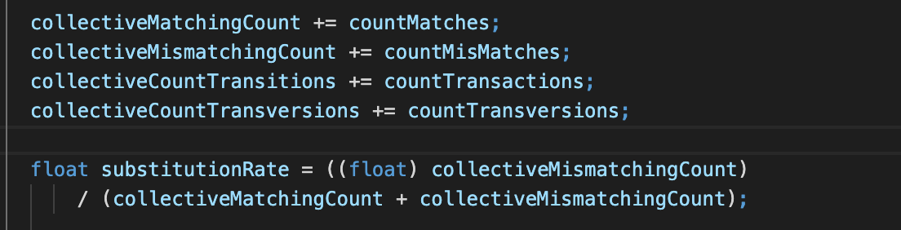
Substitution Rate Code
Bioinformatics

Slide 8
Gap Rate
In bioinformatics, gaps are used to account for genetic mutations occurring from insertions or deletions in the sequence
Gap Rate : Gap Count
___________________________
Match Count + Mismatch Count + Gap Count
Bioinformatics

Slide 9
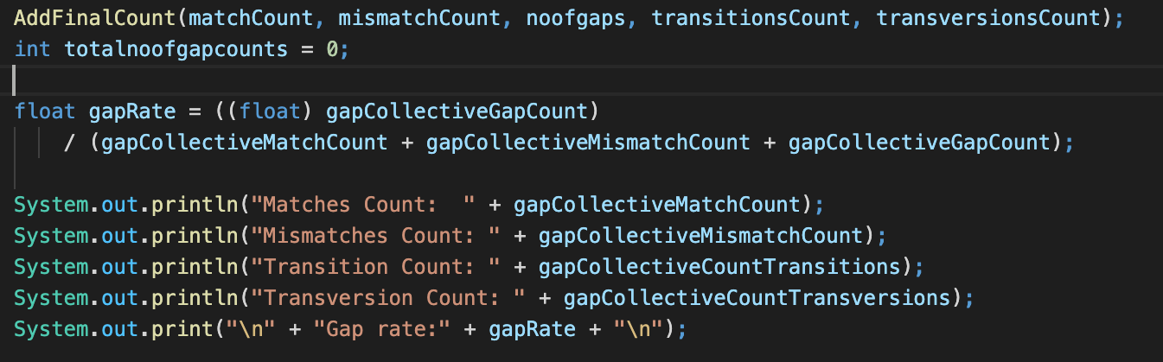
Gap Rate Code
Bioinformatics

Slide 10
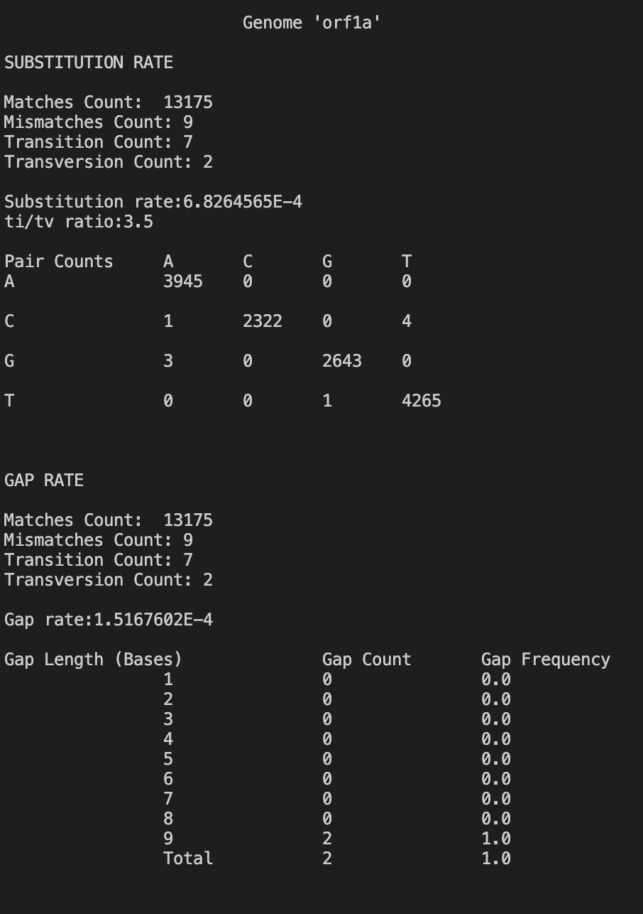
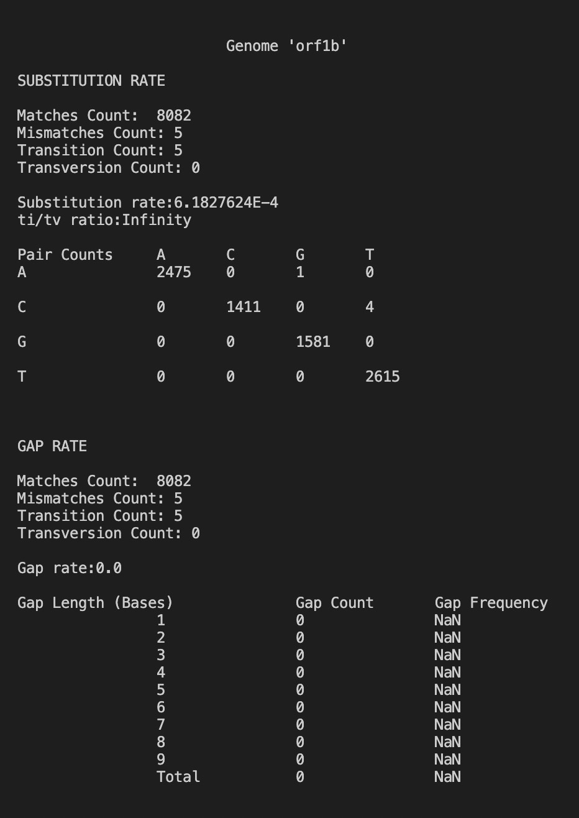
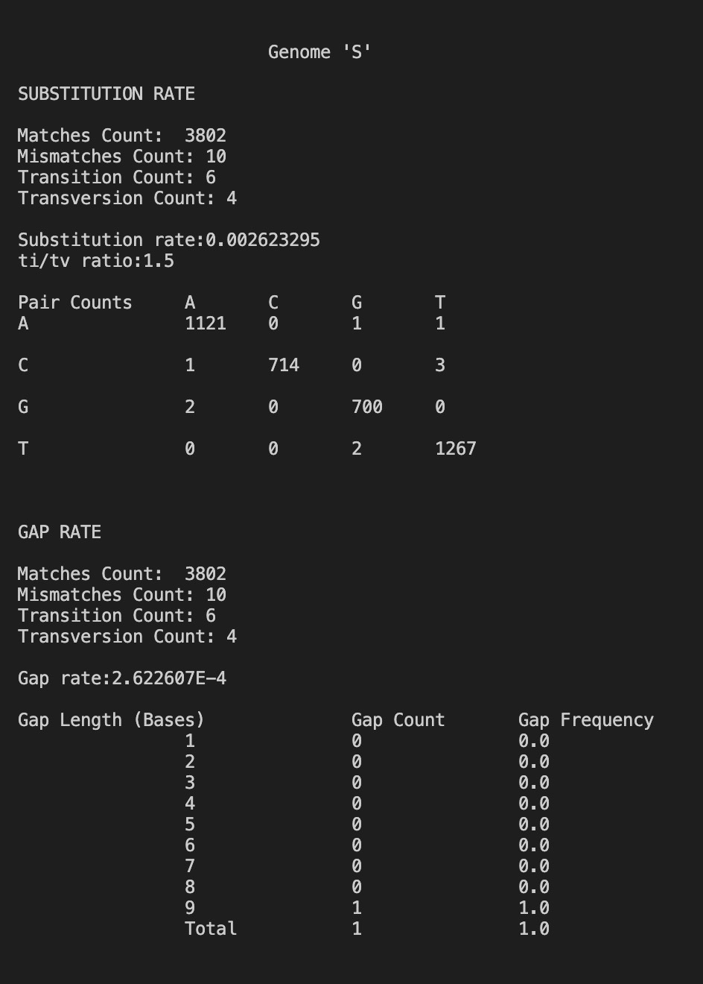
Results
Bioinformatics

Slide 11
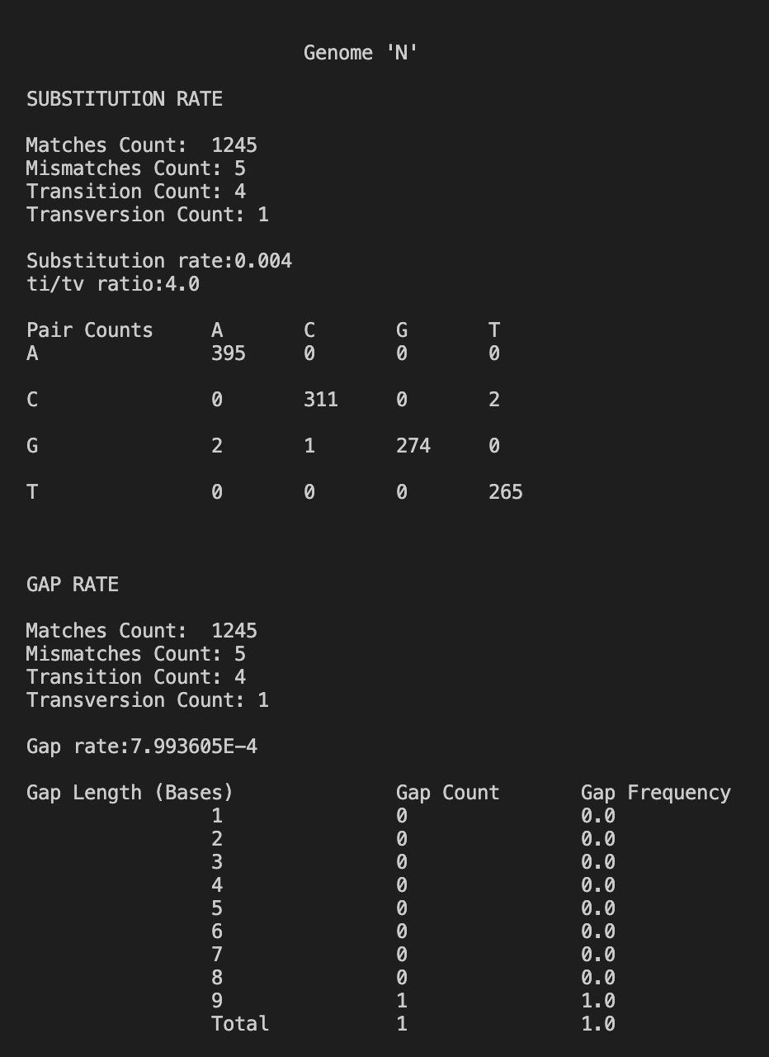
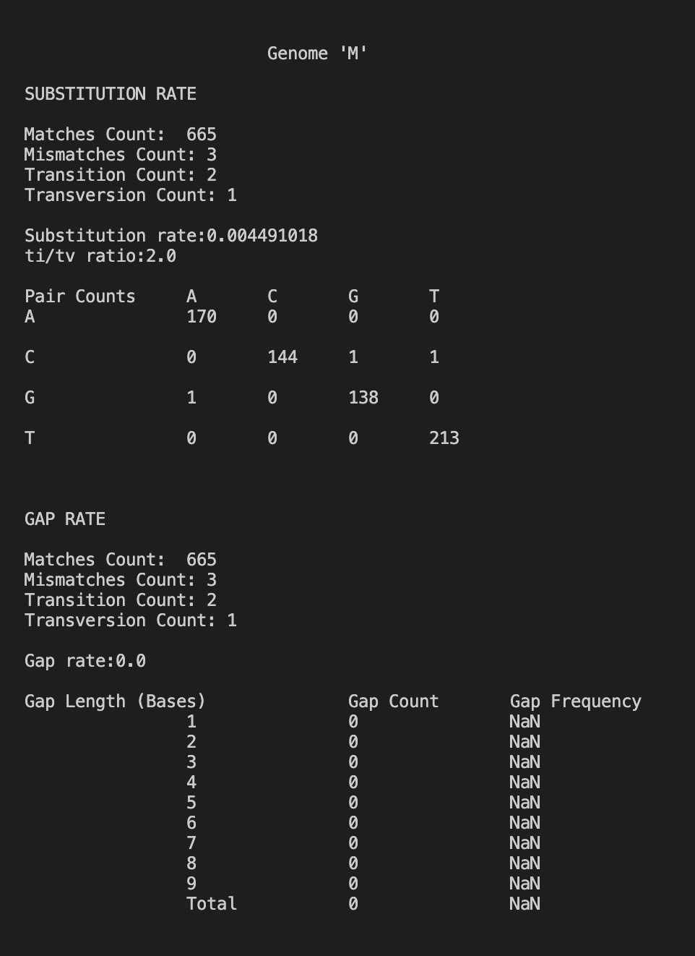
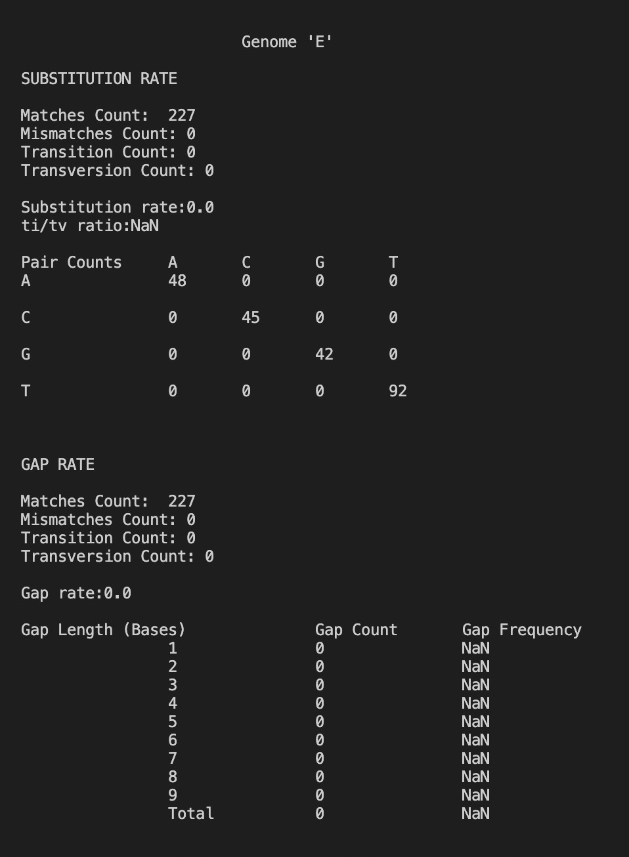
Results
Bioinformatics

Slide 12
Team member’s contribution:
Project management: Mahima (35%), Dinesh (30%), Ganesh (35%)
Implementation: Ganesh (30%), Dinesh (40%), Mahima (30%)
Coding & Design: Dinesh (35%), Mahima (35%), Ganesh (30%) Presentation: Dinesh (30%), Mahima (30%), Ganesh (40%)
Bioinformatics

Slide 13
Thank You
Bioinformatics

